Slide 1
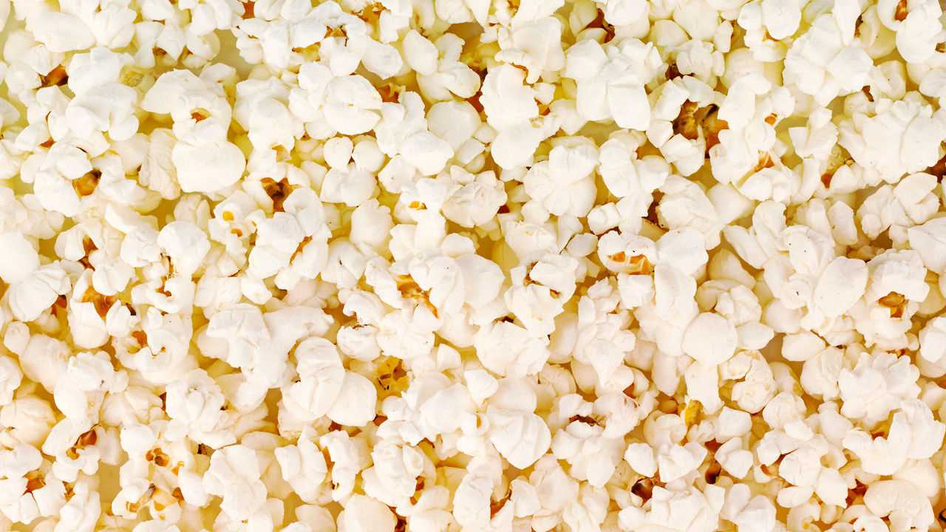
Heat Transfer
Popcorn Lab
Question: How can we use conduction, convection and radiation to pop popcorn kernels?

Slide 2
In your notebook, describe a time when you made (or ate) popcorn…
- How was it made?
- What did it taste like?
- Who was involved making it?
- Did you burn your tongue or hand while eating it?
Share with a neighbor.

Slide 3
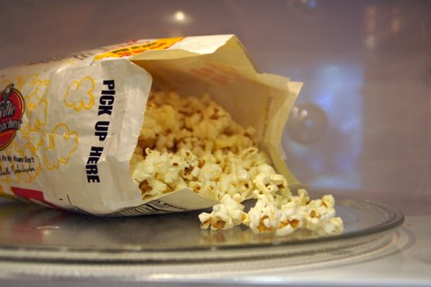
Microwaved Popcorn
1. Make observations as the popcorn is popped.
2. How are the kernels being heated?
3. What type of heat transfer is this?
 | Color | Smell | Texture | Taste
Microwave
Stovetop
Air Popper

Slide 4
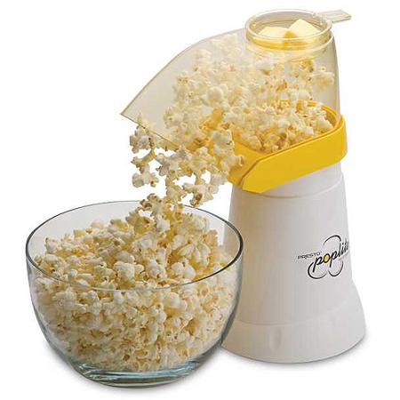
Air Popper
1. Observe what happens as the popcorn is popped.
2. How are the kernels being heated?
3. What type of heat transfer is this?
 | Color | Smell | Texture | Taste
Microwave
Stovetop
Air Popper

Slide 5
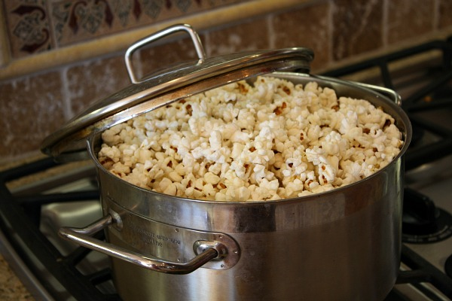
Stovetop Popcorn
1. Observe what happens
as the popcorn is popped.
2. How are the kernels being heated?
3. What type of heat transfer is this?
 | Color | Smell | Texture | Taste
Microwave
Stovetop
Air Popper

Slide 6
Popcorn Lab Reflection
1. Explain how microwaved popcorn is an example of radiation heat transfer. You may use pictures to elaborate.
2. Explain how air popped popcorn is an example of convection heat transfer. You may use pictures to elaborate.
3. Explain how stovetop popcorn is an example of conduction heat transfer. You may use pictures to elaborate.
4. Rate this activity on a scale of 1-5 (1=horrible 2=bad 3=ok 4=good 5=awesome). Why do you feel this way?

