Slide 1
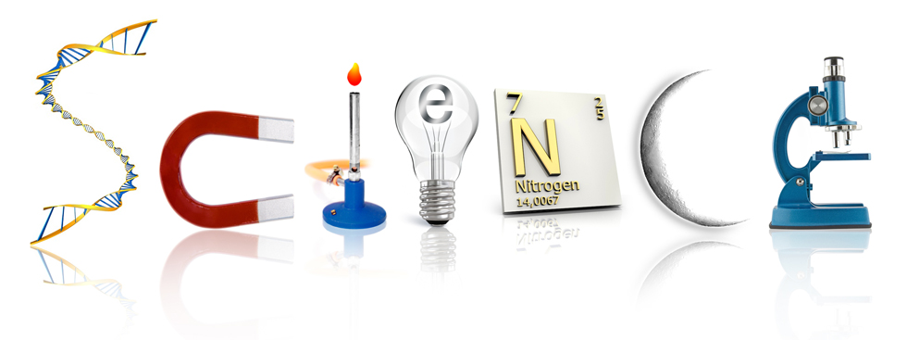
What will we learn this year?

Slide 2
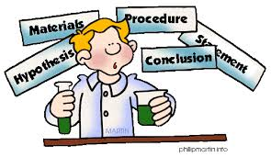
How to design an experiment…
Use 5 questions on back bulletin board to help
Use vocabulary and ideas from the Scientific Method

Slide 3
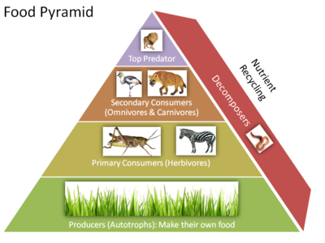
Ecosystems
5.L.2 Understand the interdependence of plants and animals with their ecosystem.

Slide 4
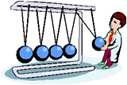
Force and Motion
5.P.1 Understand force, motion and the relationship between them.

Slide 5
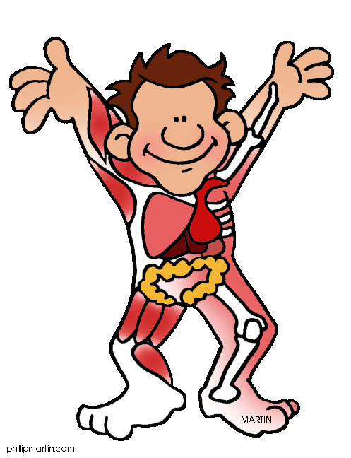
Structures and Functions of Living Organisms
5.L.1 Understand how structures and systems of organisms (to include the human body) perform functions necessary for life.

Slide 6
Evolution and Genetics
5.L.3 Understand why organisms differ from or are similar to their parents based on the characteristics of the organism.

Slide 7
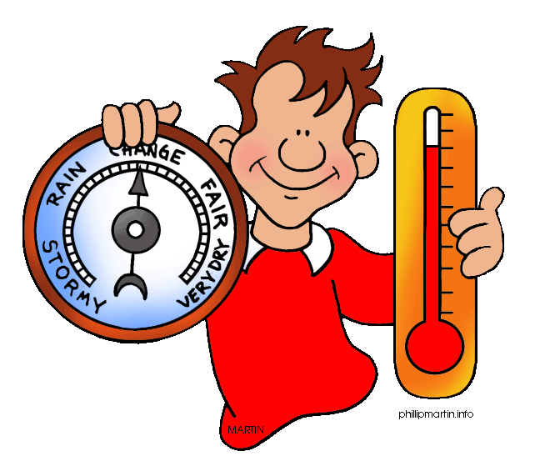
Earth Systems, Structures and Processes
5.E.1 Understand weather patterns and phenomena, making connections to the weather in a particular place and time.

Slide 8
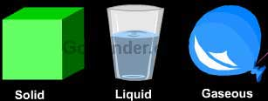
Matter: Properties and Change
5.P.2 Understand the interactions of matter and energy and the changes that occur.

Slide 9
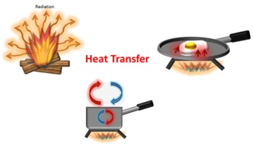
Energy Conservation and Transfer
5.P.3 Explain how the properties of some materials change as a result of heating and cooling.

